Slide 1
KEYLOGGERS
Presented by :
K.ANUSHIYA - Cse department – Holy cross engineering College

Slide 2
CONTENT
What is Keyloggers Types of Keyloggers How Keylogger work
How to Protect Yourself Against Keyloggers
What are keyloggers used for
Examples of keyloggers Conclusion

Slide 3
WHAT IS KEYLOGGERS
Keylogger is a computer program that records every keystroke made by a computer user, to gain fraudulent access to passwords and other confidential information. Keylogging is also known as Keystroke logging. It can also be used to study humancomputer interaction. There are two basic purpose to use Keyloggers. To monitor employee performance To access confidential information

Slide 4
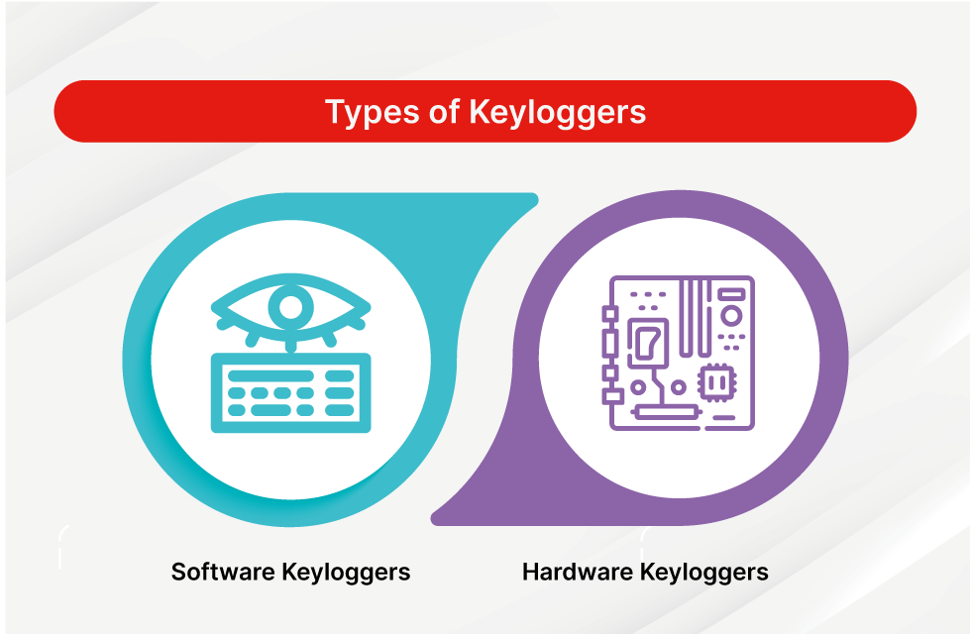
TYPES OF KEYLOGGERS
There are different types of Keyloggers divided into two main groups: Hardware Keyloggers Software Keyloggers

Slide 5
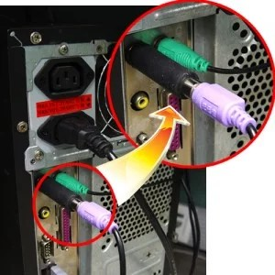
HARDWARE KEYLOGGERS
Hardware Keyloggers are small electronic devices used for capturing the data in between a keyboard device and I/O port. Usually these devices have built in memory where they store the keystrokes so this means they must be retrieved by the person who installed it in order to obtain the information. Hardware Keyloggers are undetectable by anti-viral software or scanners since it works on the hardware platform

Slide 6
SOFTWARE KEYLOGGERS
Software Keyloggers track systems, collect keystroke data within the target operating system, store them on disk or in remote locations, and send them to the attacker. They can run for an indefinite amount of time while the info is being transmitted remotely. There are three ways to install the Keylogger software. Install it from a compact disc or floppy disk. As a computer virus or Trojan horse. Gain access to the computer over a network and install surveillance software remotely.

Slide 7

HOW KEYLOGGERS WORK
Keyloggers work by recording the interactions a user has with their keyboard, allowing someone to access a log of every email, instant message, search query, password, username, or other keyed sequences that a user types.
keylogging malware can infect your computer through many of the same mechanisms as other common viruses, but keyloggers can also be intentionally purchased and downloaded.

Slide 8
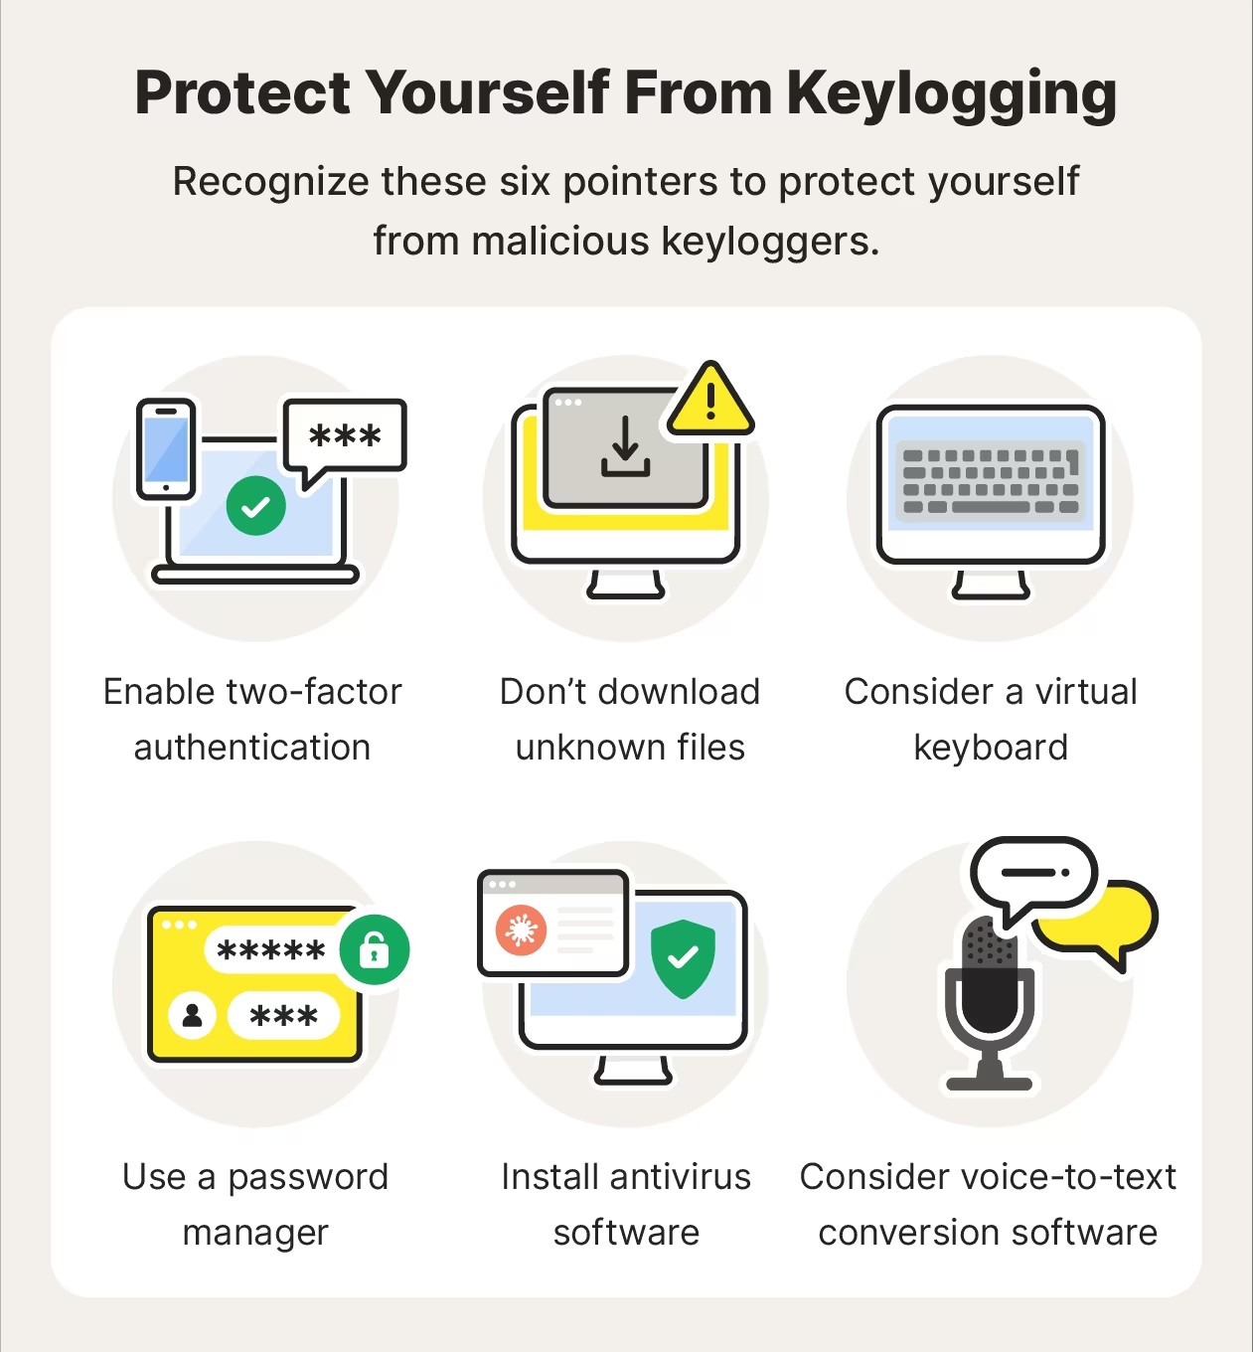
HOW TO PROTECT YOURSELF AGAINST KEYLOGGERS:
The best protection against keylogging attacks is education about how the attacks occur.
Verify that emails are sent from legitimate sources. Check for unusual email addresses and consider whether requests are legitimate. For example, question whether your bank would ask you to reset your password in an email. When in doubt, avoid clicking the link. You can still perform the requested action, such as resetting your password, directly from your bank’s portal.
Use a unique and strong password. It’s important to use unique passwords so that cybercriminals don’t have access to all your accounts if a password is compromised.

Slide 9
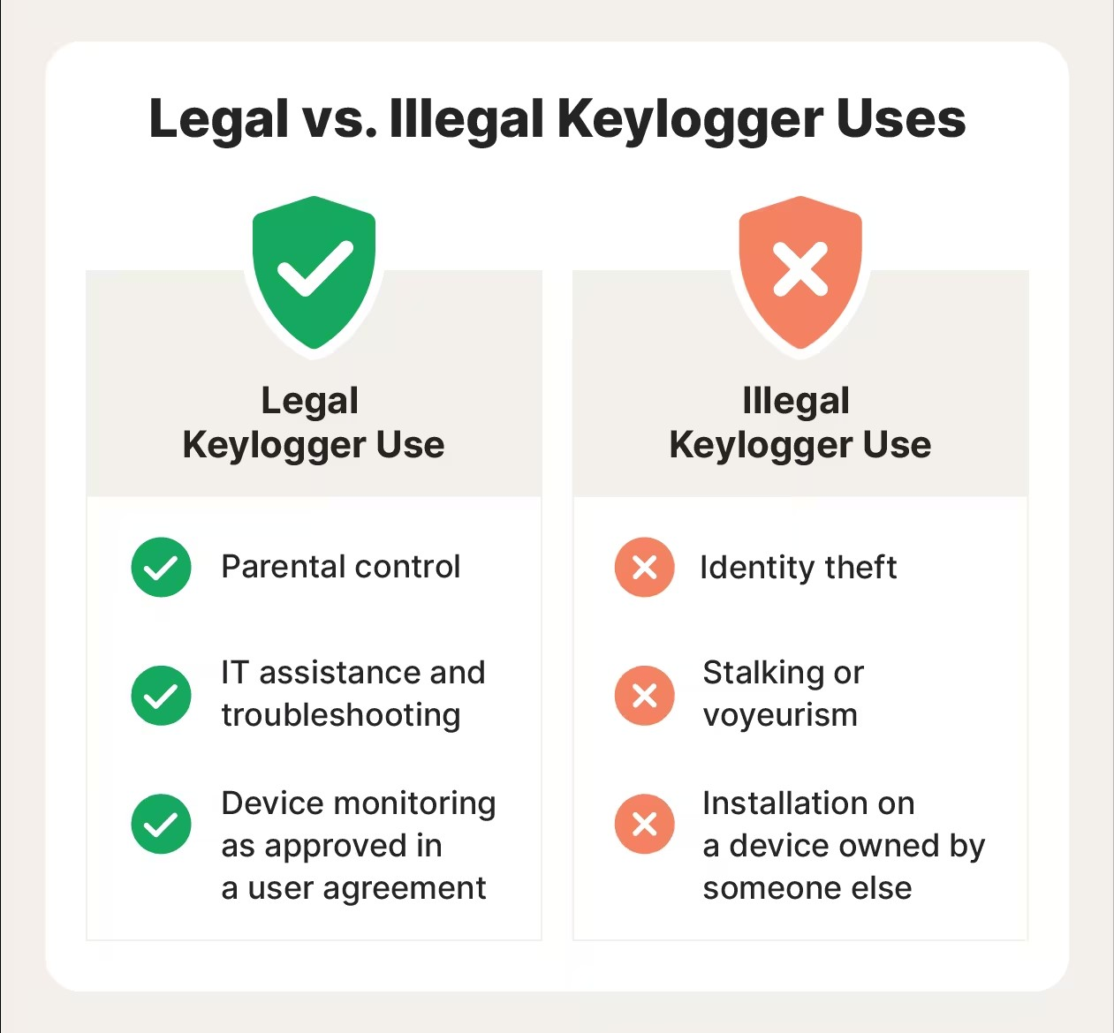
WHAT ARE KEYLOGGERS USED FOR:
Some form or another, keyloggers have been in use for decades. These days, keyloggers are one the most common forms of malware, but they are also often packaged with other types of malware as part of a suite of Trojan viruses.
But is a keylogger illegal in and of itself? Not necessarily. Let’s look at legal versus illegal usage examples.

Slide 10
EXAMPLES OF KEYLOGGERS
Revealer Keylogger is a software that records all the activities of a user’s computer that it has been installed.
Ardamax Keylogger is a Keylogger software that enables the capturing of user activity and keeping of any documentation and logs files into an encrypted space for documentation.
WinSpy is a software keylogger that allows its users to monitor numerous computers on a network, whether online or offline.
Invisible Keylogger, just as its name possesses, can function incognito in the background of the targeted computer, and record keystrokes without showing any sign.

Slide 11
CONCLUSION
Keyloggers are a potent threat to both individuals and enterprises, with the potential to cause significant harm if left undetected.
As we rely more heavily on digital platforms for various aspects of our lives, understanding cybersecurity threats like keyloggers becomes increasingly crucial. Keyloggers, whether hardware or software, pose a significant risk, collecting personal and sensitive data without the user’s knowledge or consent. Detecting them can be challenging, but with the right security tools like McAfee and safe online practices, you can protect your data and maintain your digital privacy.

Slide 12
THANKYOU

